Slide 1
Week 3-4

Slide 2
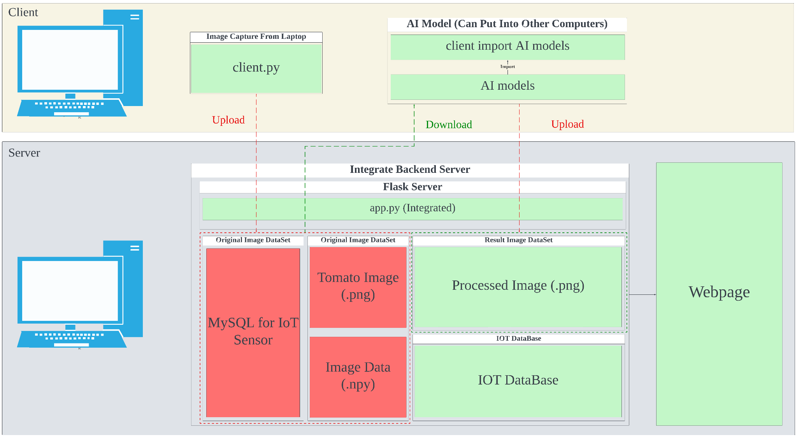
Integrate and Testing

Slide 3
Integrate and Testing
Backend Architecture Running Perfect
Plan to deployed the server on to the Google Cloud
A copy of the whole system is in the lab computer
We can use client to upload and download the file to the server in the lab computer
Figuring a way to let webpage access by other computer in same local network

